Slide 1
Remotely authenticating against the Service Framework

Slide 2
Cathal Connolly
Senior Engineer DNN Corporation
Head of the security team
Asp.net MVP

Slide 3
What’s available today?
DNN 6.2.0-7.4.1 offer authentication via MessageHandlers

Slide 4
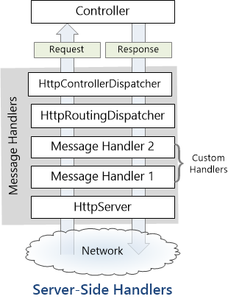
What’s a message handler?
A message handler is a class that receives an HTTP request and returns an HTTP response. Message handlers derive from the abstract HttpMessageHandler class.
Typically, a series of message handlers are chained together. The first handler receives an HTTP request, does some processing, and gives the request to the next handler. At some point, the response is created and goes back up the chain. This pattern is called a delegating handler.

Slide 5
Authentication Handlers
Immediately after the context is determined the various authentication message handlers run.
If the request is already authenticated the subsequent handlers each short circuit and do nothing.
If a valid web forms cookie is present in the request then ASP.Net will have already authenticated the request before any of the WebAPI handlers runs.
The order of the handlers is not particularly important as long as the WebFormsAuthMessageHandler always runs last. (this handler does a MembershipModule.AuthenticateRequest which completes the authentication within the DNN framework. There is no short circuit for this handler and it will always run.

Slide 6
Basic Authentication

Slide 7
Basic - How it works?
HTTP Basic authentication implementation is the simplest technique for enforcing access controls to web resources because it doesn't require cookies, session identifier or login pages.
HTTP Basic authentication uses static, standard HTTP headers which means that no handshakes have to be done in anticipation.
There are some browser extensions to invalidate requests – but not reliable.

Slide 8
Basic Authentication
DEMO

Slide 9
Basic - Pro’s and Con’s
Pro’s
Simple to implement
Works with anything that “talks” HTTP
Con’s
Requires username and password in calling application
Unprotected unless under TLS

Slide 10
Digest Authentication

Slide 11
Digest - How it works?
Digest authentication is an application of MD5 cryptographic hashing with usage of nonce values to prevent replay attacks.
Designed to be stronger than Basic as it doesn’t send the password in plain text, but rather a hash that is compared on the server end
Sent as a customer authentication header, the values are parsed and verified and if valid the user is logged on.

Slide 12
Digest- Pro’s and Con’s
Pro’s
Better than basic as only a password digest is passed
Simple to invoke from client script as javascript can generate MD5
Con’s
Requires retrievable passwords so wont work in default DNN 7.0.0+ (unless passwordFormat changed)
Wont work in FIPS environment
MD5 is easily crackable
Username is still clear
Really needs TLS to be viable

Slide 13
WebForms Authentication
The standard forms authentication cookie based authentication.
Also act’s to correctly “login” authenticated principles
Note: remote client’s can utilise this by storing cookies in a container and “scraping” the relevant page to ensure event validation is in place.

Slide 14
What’s coming in 8.0
8.0.0 now uses WebAPI 2.1 which allows us to utilise Authentication Attributes
8.0.0 will ship with two new ones
HMAC
OAUTH 2.0
An easy extension point for new authentication methods.
As authentication happens before authorization, it can reuse existing authorization attributes (where applicable to auth scheme)

Slide 15
HMAC Authentication

Slide 16
HMAC- How it works?
Mechanism for calculating a MAC using a hash function with a shared “secret” key.
In cryptography, a keyed-hash message authentication code (HMAC) is a specific construction for calculating a message authentication code (MAC) involving a cryptographic hash function in combination with a secret cryptographic key.
As with any MAC, it may be used to simultaneously verify both the data integrity and the authentication of a message.

Slide 17
HMAC –integrity & authenticity
An altered message can cause the message recipient to behave in an unintended and undesired way. The message recipient should verify that the incoming message has not been tampered with.
An attacker could pose as a legitimate sender and send falsified messages. The message recipient should verify that incoming messages originated from a legitimate sender.
Due to requests being verifiable there is no need to worry about cross-site request forgery.

Slide 18
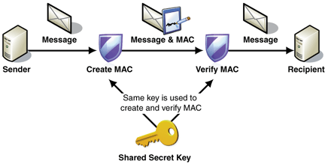
HMAC- How it works?
We use a symmetric signature i.e. a single shared “secret” key, rather than an asymmetric signature (which would require a public/private key pair)

Slide 19
HMAC- How it works?
Add a custom authorization header that contains the AppID, message signature, nonce and timestamp.
The nonce is a unique value and specifically to stop replay attacks (unlike digest where it may be a simple timestamp). DNN will cache this nonce value for 5 minutes and any attempt to replay a request with a previously used nonce will fail.
The timestamp is a unix timestamp is generated and used as part of the key. The server evaluates when it is processing it that it is within a predetermined timeframe.
The AppId will be used to look up the AppSecret associated with that account and attempt to parse/validate the signature.

Slide 20
HMAC- Pro’s and Con’s
Pro’s
No requirement for TLS
No sensitive data is viewable
Mechanism also verifies integrity as well as authentication.
Choice of hashing algorithm (MD5, SHA1, SHA256) – DNN’s implementation is SHA256 to maximise security and allow it to work in a FIPS environment
Con’s
Requires AppId and AppSecret to be generated and added to the remote application

Slide 21
HMAC Authentication
DEMO

Slide 22
OAUTH Authentication
Not OAUTH Client support – this already exists and is leveraged by a number of authentication providers.
8.0.0 will be adding OAUTH Server support.

Slide 23
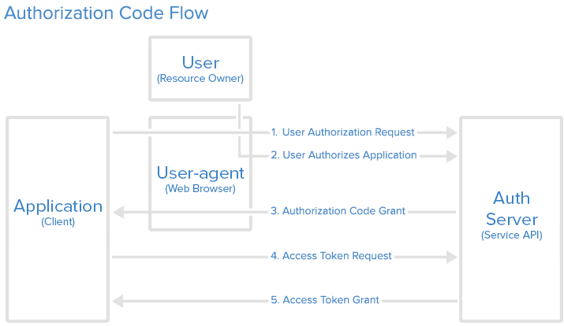
Authorization Code Grant flow
The authorization code grant type is the most commonly used because it is optimized for server-side applications, where source code is not publicly exposed, and Client Secret confidentiality can be maintained. This is a redirection-based flow, which means that the application must be capable of interacting with the user-agent (i.e. the user's web browser) and receiving API authorization codes that are routed through the user-agent.

Slide 24
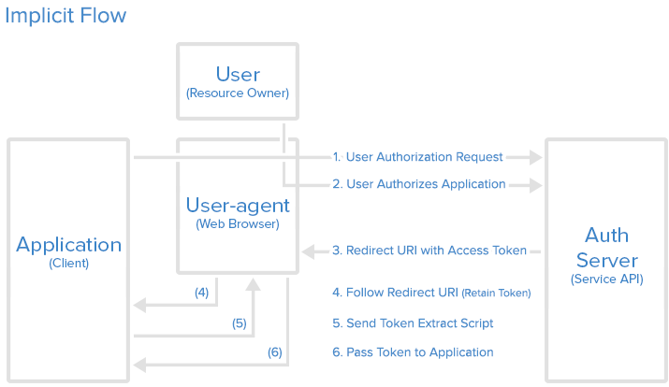
Implicit Grant flow
The implicit grant type is used for mobile apps and web applications (i.e. applications that run in a web browser), where the client secret confidentiality is not guaranteed. The implicit grant type is also a redirection-based flow but the access token is given to the user-agent to forward to the application, so it may be exposed to the user and other applications on the user's device. Also, this flow does not authenticate the identity of the application, and relies on the redirect URI (that was registered with the service) to serve this purpose

Slide 25
OAUTH Authentication
NO DEMO – hopefully CTP3

Slide 26
Questions?

