Slide 1
BUILD CROSS-PLATFORM NATIVE MOBILE APP FOR DNN
DNN Mobi

Slide 2
Ash Prasad
DNN Corp.

Slide 3
Agenda
The App (demo)
DNN Web Api History
Mobile Development Platforms
Appcelerator – View, Controller, Markup
Appcelerator Dev Environment
Tips
Code Walkthrough
Debugging
Emulators

Slide 4
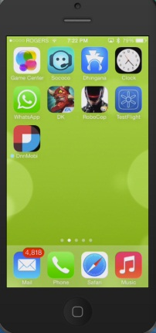
About Me – Ash Prasad
DNN Corp
Sr. Manager, Development
Langley, Canadian office
Look after Evoq products
Creator of DNN 7.1 Search
Microsoft Asp.Net / IIS MVP
Author: Professional DNN7: Open Source .NET CMS Platform
DnnMobi Creator
CISSP

Slide 5
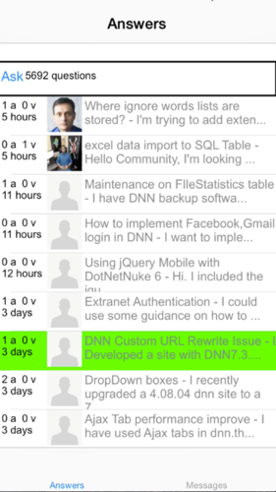
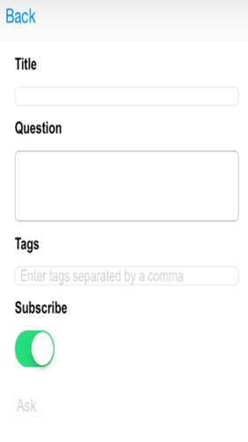
UI – Look & Feel
Login Questions List View Ask a Question

Slide 6
App Demo

Slide 7
DNN Web Api
Dnn Web Apis are AWESOME!!!
BUT
Not Mobile Friendly

Slide 8
So, What’s Missing
Just 4 things

Slide 9
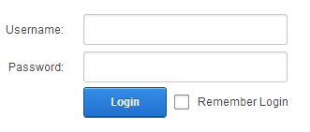
1. Login
..a way to login

Slide 10
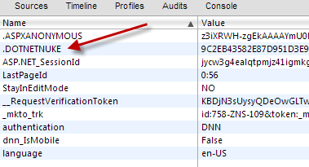
1. Shuttle Cookies
...between app and Web API

Slide 11
3. Antiforgery Token
..send to Web API

Slide 12
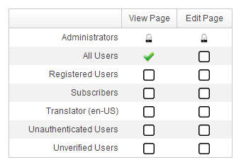
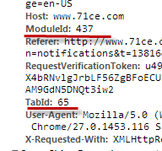
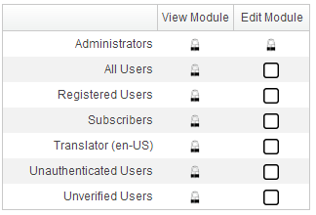
4. Page and Module Security
..send Module & Tab Ids to Web API

Slide 13
So, what did I do?
First .. stop complaining...instead do something

Slide 14
I built a team
Me – Architect & Developer
My wife – UI design
My Kids – QA
Our family time
Our own hardware / software / app store certificates
All open source

Slide 15
I looked at various frameworks
Icenium (Telerik)
PhoneGap
Xamarin
Native Android
Native iOS
Appcelerator

Slide 16
Winner
…..Appcelerator

Slide 17
Why Appcelerator
Cross Platform
iOS, Android, Blackberry, Tizen
Windows Phone (coming)
MVC Architecture (Alloy)
JS / Html / CSS (tss)
No need to learn Native
All open source - Free

Slide 18
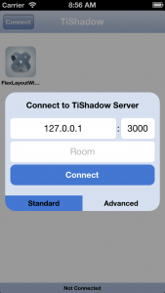
Development Environment
Mac (Android and iOS)
or
PC (Android only)
Titanium Studio
FREE, Open Source
Alloy MVC framework
Genymotion
FREE - very fast Android emulator
TiShadow

Slide 19
Development Environment (contd.)
SublimeText3 (Optional)
There are plugins for Titanium
Developer certificates
Apple and Google- $$$
DNN Site
DnnMobiHelper installed
Android phone – set in Developer mode
TestFlight (optional)

Slide 20
Architecture
Mobile
Server
New Library - Login, AntiForgery, Cookie, Module/TabId
One new Web API
Core FE
Core Web APIs
Your FE
Your Web APIs

Slide 21
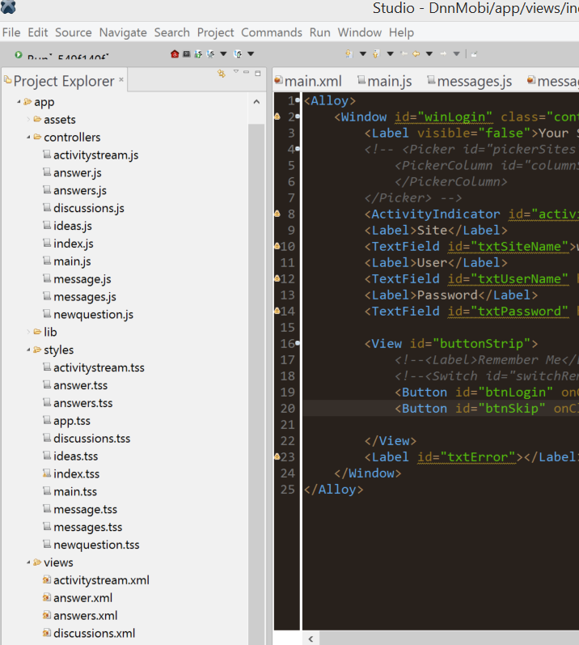
Appcelerator MVC
View
XML markup
Style
TSS (css)
Controller –
JS code behind

Slide 22
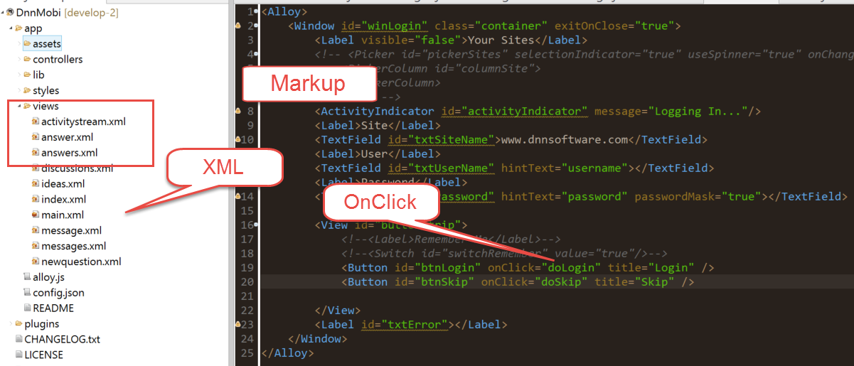
Appcelerator - View

Slide 23
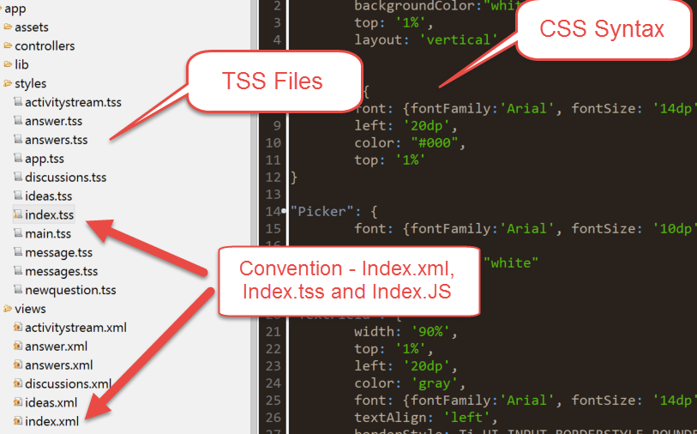
Appcelerator - Style

Slide 24
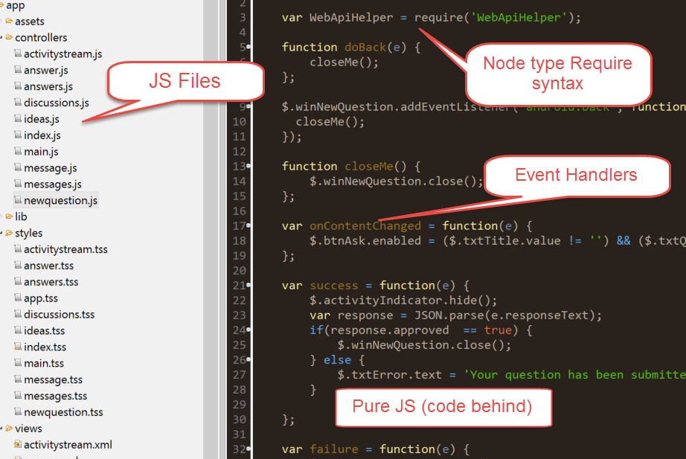
Appcelerator - JS

Slide 25
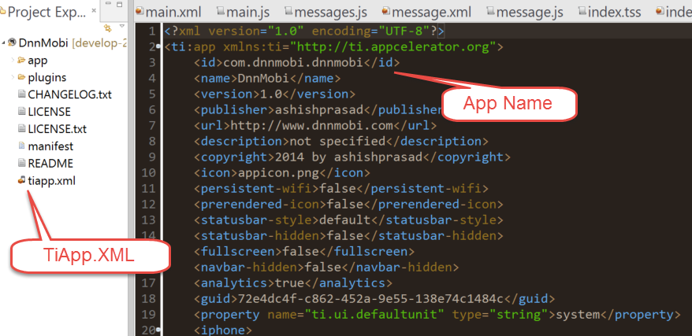
Appcelerator – TiApp.Xml

Slide 26
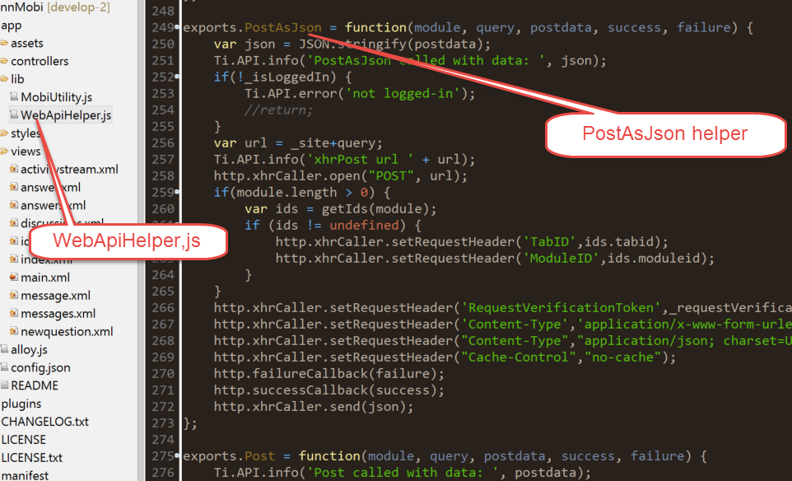
Appcelerator – Library
Login
Get
Post
TabId
ModuleId
Antiforgery
Logoff
IsLoggedIn

Slide 27
UI Flow – Login to Answers

Slide 28
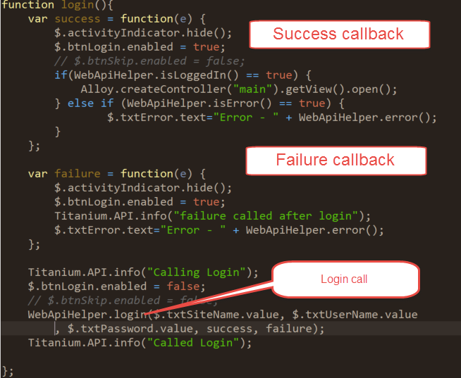
Data Flow – Login
2 Callbacks
Success
Open Main
Failure
Show error
WebApiHelper
Login

Slide 29
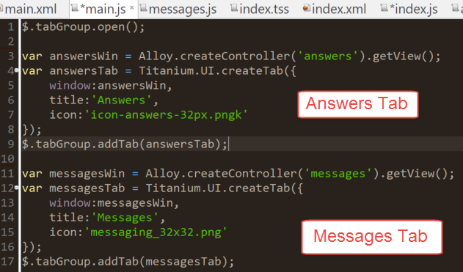
Data Flow - Main
TabGroup
Add tabs
Answers
Messages

Slide 30
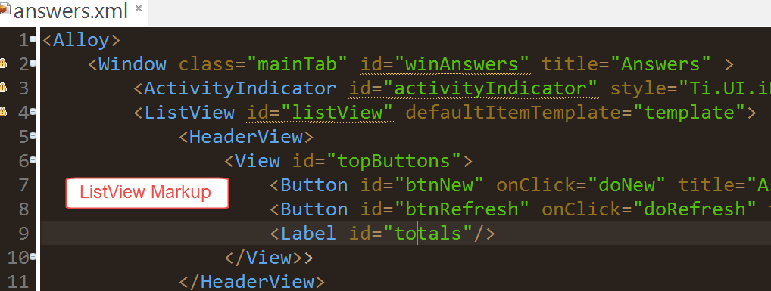
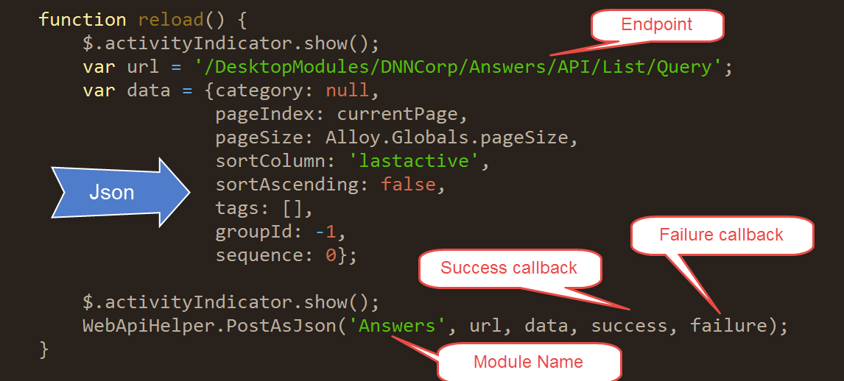
Data Flow - Answers
ListView
Template
WebApi
Auto Load
Databind

Slide 31
Tips
Use Genymotion for Android
Google’s Emulator – Very Slow
Xcode emulators - pretty good
Use TiShadow for faster dev
Test on physical devices often
Android and iOS are DIFFERENT
Accept it!!

Slide 32
Tips (cond..)
Understand Layout
horizontal vs. vertical
Brush up on JS
Understand DNN Security
Use WebApi attributes
Cookies

Slide 33
Code Demo

Slide 34
Source Code
Appcelerator based App’s source code
https://github.com/ashishpd/DnnMobile/tree/master/DnnMobi
DnnMobiHelper (install on DNN)
https://github.com/ashishpd/DnnMobile/tree/master/DnnMobiHelper

Slide 35
Questions?

