Slide 1
presents
Notes:
An enterprise-ready commerce solution, without the enterprise problems or the enterprise price tag.
How many people are:
DNN users?
Developers?
Designers?
System implementors?

Slide 2
AGENDA
Introduction
Background
Core Values
Final Q&A

Slide 3
Will Strohl
Director, Product Development
Author, founder of DNNCon, former ODUG President, 20+ OSS projects, former DNN Corp employee

Slide 4
REAL TEAM, REAL PROCESS
Notes:
This is our team (except for a few people that haven’t taken a company photo yet)
We have a dedicated team of support, UX/design, development, QA, and marketing staff ensuring the best possible product
Customer service focused
Quality driven

Slide 5
FLEXIBLE ARCHITECTURE
Hotcakes Commerce
Evoq Content
Evoq Social
DNN Platform
Notes:
Mention that we follow DNN development best practices as well
Simple to install
Easy to upgrade
No core changes
No manual changes
Using core features
Be transparent about one exception – the SqlDataProvider file tokens

Slide 6
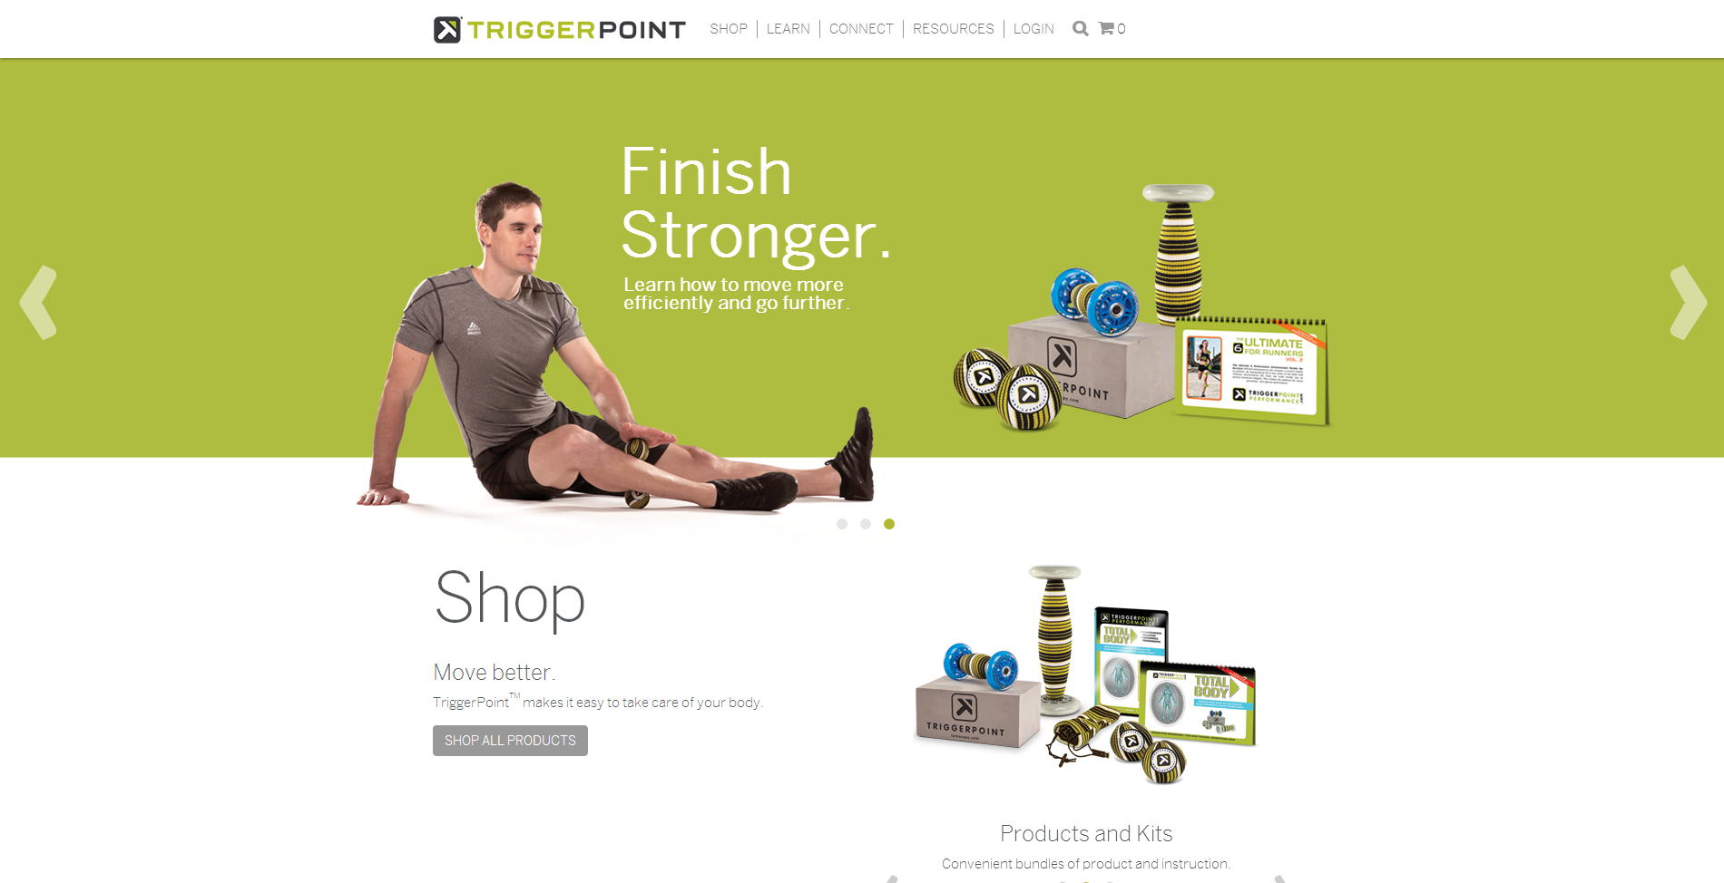
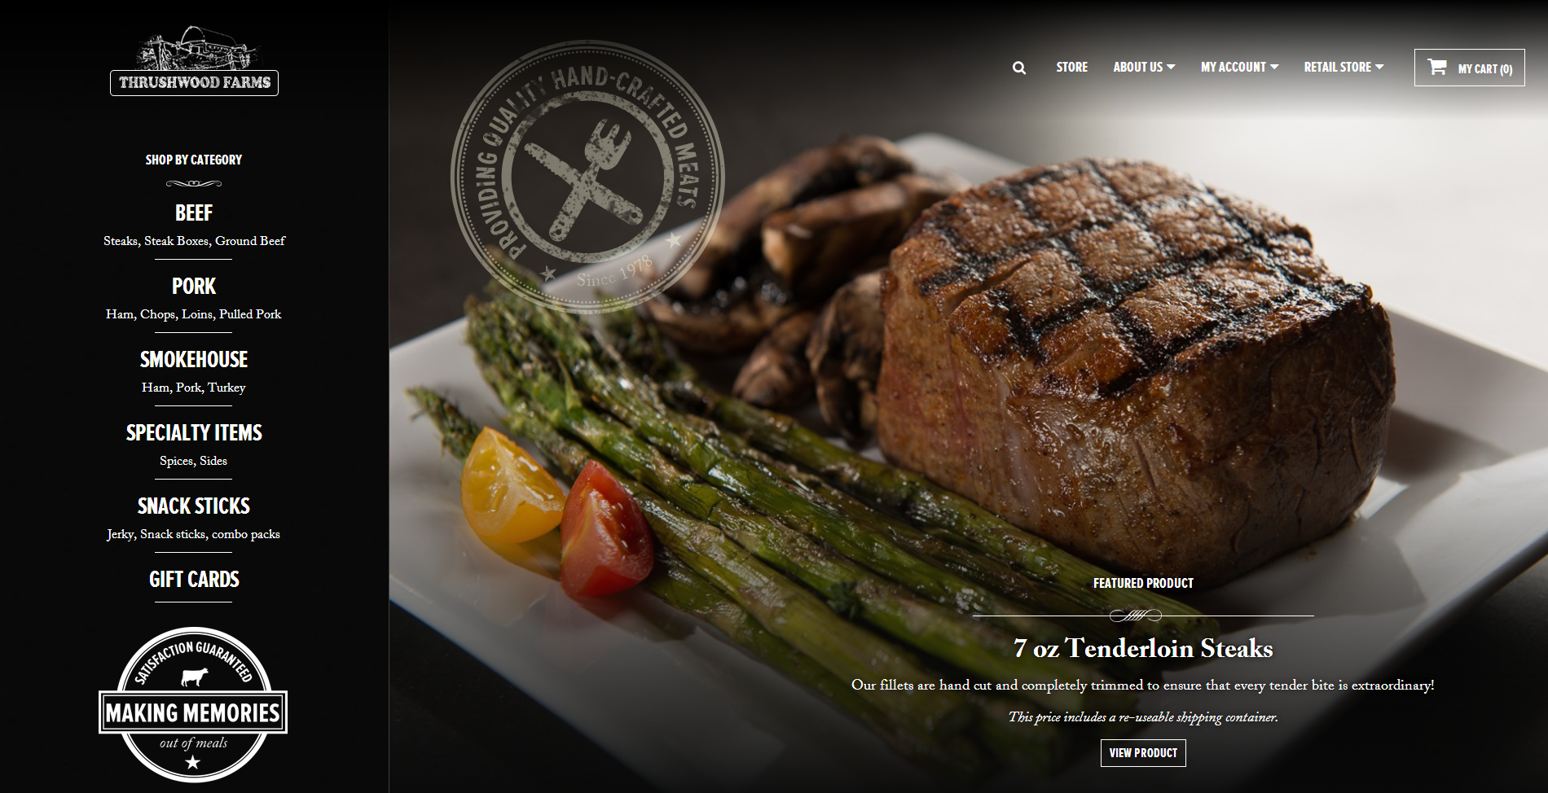
BEAUTIFUL RESULTS

Slide 7
AWESOME SYSTEM IMPLEMENTORS
Notes:
Give Duotix & Glamacy a moment to say something about HCC

Slide 8
Engaging Customer Experience Exceptional Merchant Experience
Happy Designers
Productive Developers

Slide 9
CUSTOMER EXPERIENCE
Responsive to Start
Single-Page Checkout
Faceted Search
Socially Integrated

Slide 10
MERCHANT EXPERIENCE
Intuitive Administration
Functional Order Administration
Administration Duties Segmentation
Customizations without Developers
Native iPhone App
Notes:
Be sure to mention
VAT support
Localization

Slide 11
DEMO
Notes:
Login as the host account
Go to Hotcakes Administration
Click into an order
Go to Edit Order
Talk about the customer that calls in after an order is placed
Go to Payment
Show how you capture funds against an authorization
Go to Shipping
Show how you can create multiple packages if you need to ship items at different times
Go to the People > Role Administration
Talk about how you can divide duties within your organization if you have multiple people doing the work of fulfillment and order administration
Go to Promotions
Add Custom Sale
Where User is in Role > Moderators
Give Discount == 5%
Save
Add Custom Offer
Show that you can have free shipping
Show multiple products as a qualifier
Show the Product Types choices
Show product types
Show the argon bike to demonstrate that the form for editing the bike is available
Show the iPhone app

Slide 12
DESIGNER EXPERIENCE
Full Control Over Rendered HTML
Fully Functional Example for Responsive
Ability to Redesign Implementations Based Upon Data
Override Views by Module, Product, or Category
Create Reusable Content Blocks For Category Headers and Footers

Slide 13
DEMO
Notes:
Open RenderSingleProduct.cshtml
Add
<p class="recordprice">
@Html.Raw(Model.UserPrice.DisplayPrice(true))
</p>
Talk about the power of intellisense and the value of not having to learn our token language
Do a search for Razor Views truncate values
Add Trim() around the ProductName
Go to the Views Manager
Show how you can make an editable copy and talk about view sets
Go to the Product Page and show you can override the View for a product
Talk about the different levels of overrides
Product Type
Product
Module
Category
Module
Talk about Content Blocks

Slide 14
DEVELOPER EXPERIENCE
Partial Views & Controllers
Custom Order Workflows
Action Delegate Pipeline for Key Areas
REST API

Slide 15
DEMO
Notes:
Open the Workflow Application
Open the Workflow
Open the Integration Application
Show the Integration Points
Show the extensibility page.
Talk about Custom Models and Controllers

Slide 16
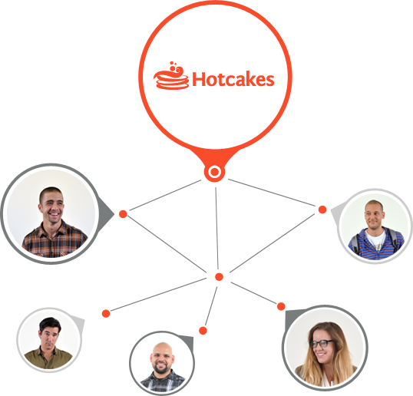
SOCIAL E-COMMERCE
Related Content and Taxonomy Integration
Activity Feed Integration
Gaming Mechanics Points
Discounts for Badges

Slide 17
LICENSING & SUPPORT
Hotcakes Commerce
$1,699 per license
Paid Support
$499 per year, per license
One-time fee (perpetual license)
Upgrade fees apply for major versions
Licensed per domain name, per server
Includes Evoq Social integration
Volume & site licensing available
Covered under an SLA
Community Support
Free
Guaranteed 2 business hour response time
Notes:
Mention the free 30 day trial

Slide 18
Coupon Code: DNNCONNECT2014
Thank You!
HotcakesCommerce.com
facebook.com/HotcakesCommerce
@MmmCommerce
Notes:
10% discount for a limited number of people

