Slide 1
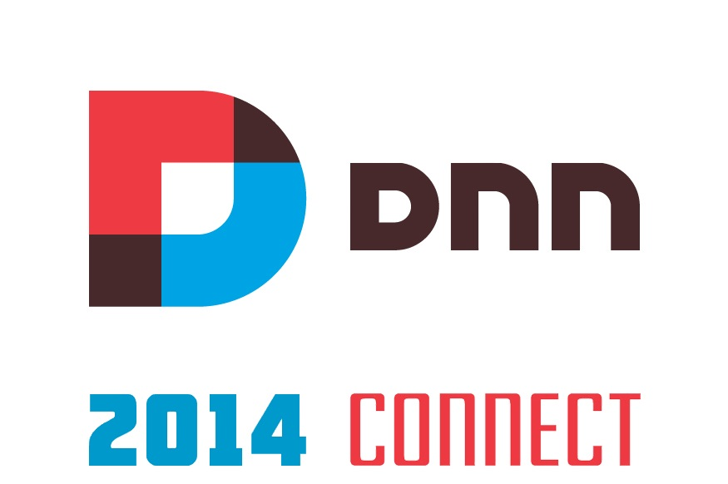

Slide 2
Enterprise E-Commerce and DotNetNuke
DNN Connect 2014

Slide 3
Thomas Stensitzki
Principal, Granikos GmbH & Co. KG i.G.
- Global Architect and Project Manager -
MCM: Exchange Server 2010
MCSE, MCSA, MCITP, MCTS, MCSA, MCSA:M, MCP
Thomas.Stensitzki@Granikos.eu

Slide 4
The Current Situation in Enterprise Environments

Slide 5
The Ideal E-Commerce World
Single Data Source
Shopping Solution
Generate Revenue

Slide 6
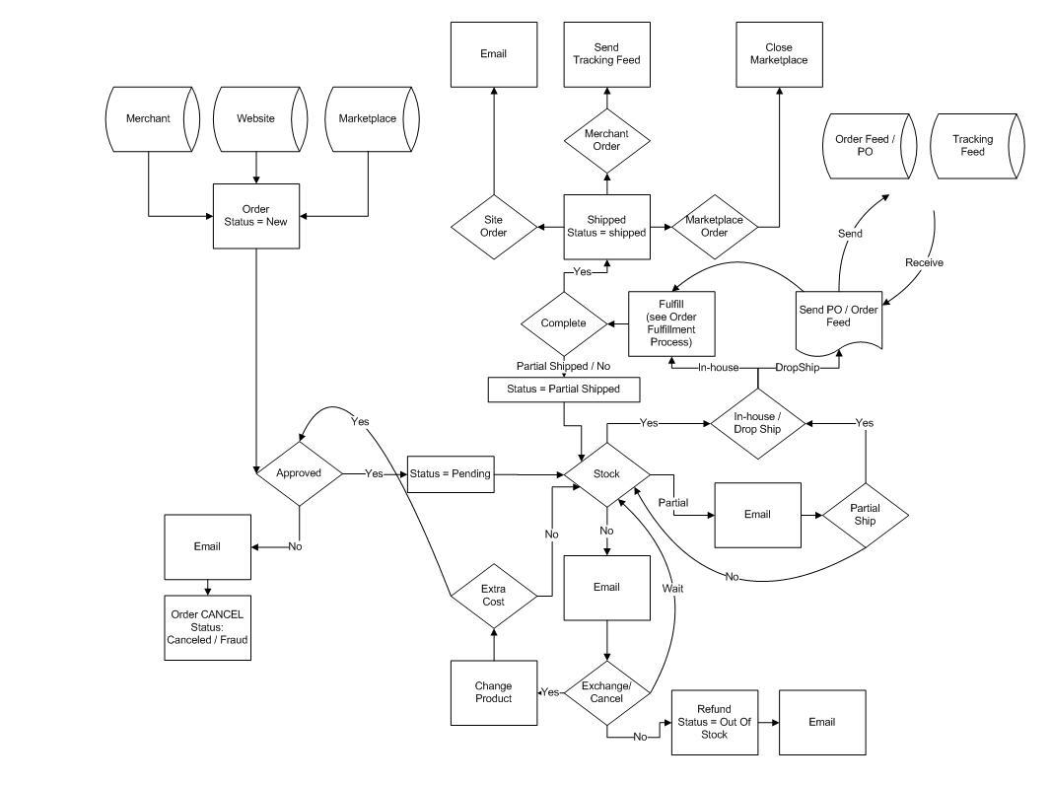
The Real E-Commerce World
Actuals
Every business is different → every IT solution is different
Business data is already managed by existing IT systems
Some business processes are already automated, some are not
Any additional IT system adds a level of discontinuity in the data flow
Leads to
Data Flow Discontinuity
Manual Work
High Costs

Slide 7
The Real E-Commerce World
Multiple Internal Data Sources
ERP
CRM
Internal Catalogues
Price tables
…
Multiple External Data Sources
Picture Libraries
Vendor Catalogues
Tax – Lists
Rebate Lists
…
Various Hosting Scenarios
On-Premise Local Servers
Hosted Services
Private Cloud
Public Cloud
…
Different Target Scenarios
Catalogues
Web-Shops
POS
Shopping Apps
...

Slide 8
Shop Software Does Not Match Business Requirements
Catalog model often does not match business requirements
Real-world pricing is often more complicated than pricing models in shop software
Product and customer data is often already available in ERP or CRM → need for regular data syncing
Order processing in online shops does not match business processes
…
Customization for 100% matching to business requirements is often…
difficult,
impossible or
requires modification of the original source code
… time consuming \ costly

Slide 9
Challenges between Business And E-Commerce Software Requirements
Business Requirements
Catalog Model often does not match Business Requirements
Real-World Pricing is often more complicated than Simple Pricing Models implemented in shop solutions
Product and Customer Data is often already available in ERP or CRM → Need for permanent Data Synchronization
Order processing in Online Shops does not match Business Pocesses
Common E-Commerce Solutions
Require Customization to match business requirements
Results in
Difficult and Complex Implementations
Source Code Customizations
Inappropriate Project Time Lines
High Implementation Costs
Just plain impossible

Slide 10
Introducing
Enterprise E-Commerce Solutions
by

Slide 11
Is…
An E-Commerce Development Platform
Highly Customizable
Easy-to-Use
Scalable
Integrated E-Commerce
Order Processing Solution
The API allows Advanced and Simplified Customization and Extensions
A Large Set of Pre-Built Extensions is available as Plug-Ins, Installable at Runtime

Slide 12
Three Layer Model
Extension Points
Pre-built packages (excerpt):
DNN Integration
Client API for
HTML5/Javascript
WPF POS
Application Integration
Nikos-One API
Plug Ins
WCF Endpoints
REST Endpoints
Client API for …
Payment
Add To Cart
PDF
Mails
Pricing
SQL Server
Data Source
Permissions
Discounts
Oracle
Data Source
Dynamics CRM
Data Source
Shipping
MySql
Data Source

Slide 13
One System Fits All

Slide 14
Why

Slide 15
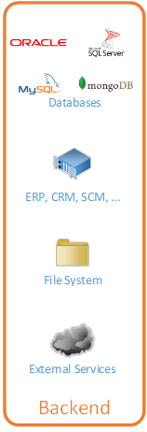
Integration into existing IT Infrastructures
Nikos One connects to any kind of Data Source with extremely low Setup Efforts
No Code Modifications needed
No Synchronization needed
Benefits:
Reduction of Time and Effort for Implementation Projects
No Requirement for additional technical Backend Expertise

Slide 16
Data Source Aggregation
Multiple Data Sources for One Single Product
Master data from Source 1, Description Texts from Source 2, Images from various other sources
Products from Multiple Sources in One Single List
Combining Data Sources of Multiple Suppliers
Benefits:
No Code Modifications needed
No Synchronization needed
Easily and Quickly adaptable

Slide 17
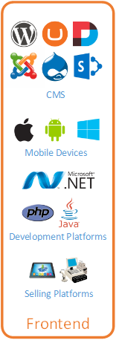
UI Technology-Independent
E-Commerce Functionality Independent from the Frontend Technology
Web Shops
Point-Of-Sale Systems
Smartphone \ Tablet Applications
Independent from the Frontend Development Platform
.NET
Java
PHP
Ruby
Benefits:
Changes of the Frontend Technology without the need to change the E-Commerce Solution

Slide 18
Simultaneity of Multiple Frontend Technologies
Different Frontend Technologies can be operated at the same time
Frontend is used as a Façade Layer
All Frontends share the same Central Administration
Frontend Technologies
Web Shops
Point-Of-Sale Systems
Smartphone \ Tablet Applications
Benefits:
Single Implementation for Business Process Connectivity
Scalable Implementation when the Business Requirements arise

Slide 19
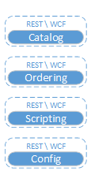
Customizable Input and Output Data Formats
The E-Commerce Platform intended to be used by humans and IT Systems for Automated Transactions and Batch processing
Input and Output Data Formats can be customized to meet the Requirements of any Upstream or Downstream Process
Examples
Protocol: e.g. REST, SOAP
Format: e.g. JSON, XML
Semantics: e.g. cXML or OCI
Benefits:
Rely on standard Protocols, Formats and Semantics
Easy to develop your own Plug-Ins and Extensions
Notes:
REST, Representational state transfer
SOAP, Simple Object Access Protocol
JSON, JavaScript Object Notation
cXML, commerce eXtensible Markup Language
OCI, Open Catalog Interface

Slide 20
Infrastructure Independent Operation
Possible Operating Modes
Private and Public Cloud
On-Premise
Hosted
E-Commerce Platform may run as:
Web application inside IIS
Windows service
Autonomous application
Benefits:
Fits into a wide variety of operation models
Operation model can be changed without interrupting the Business

Slide 21
Stand-Alone vs. Embedded
Stand-Alone Shop Web Site
Embedded into existing Web Site
In both cases:
Independent from UI technology and Development Platform

Slide 22
Administrator and Developer Friendly
The Complete Configuration is Scriptable
Script Generation from existing configuration allows Easy Backup and Migration
Integrated into Visual Studio
Uses Visual Studio‘s Workflow Editor
Benefits:
Tools known to Developers and Administrators

Slide 23
DotNetNuke and Nikos One
Full flegded E-Commerce Solution for the DNN Platform
Three different Nikos One Versions
Community
Professional
Enterprise
Extensibility through additional Nikos One Plug-Ins
Multi Language
Data Storage within DNN Database or external Data Sources (partially in Community Edition)

Slide 24
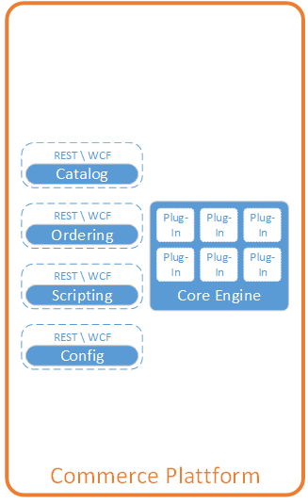
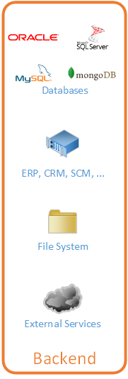

Slide 25
Available
Q3 2014
Stay connected at
http://dnnconnect.nikos-one.eu

Slide 26
Questions?
Notes:
Offener Punkte: Rechtsform des Unternehmens

Slide 27
Available
Q3 2014
Stay connected at
http://dnnconnect.nikos-one.eu

